Slide 1
Data
link
Application Layer
Session
Network
1000byte
8byte
20byte
22byte
Total size: 8400bits

Slide 2
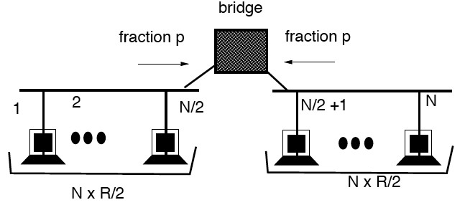

Slide 3
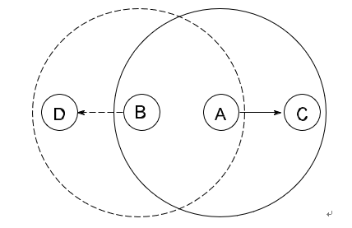
Collision
CTS
Interference

Slide 4
Collision
Data
Interference
ACK

Slide 5
Switch 1
Switch 2
Switch 3
Switch 4
Incoming |  | Outgoing |  | Incoming |  | Outgoing |  | Incoming |  | Outgoing |  | Incoming |  | Outgoing
Port | VCI | Port | VCI | Port | VCI | Port | VCI | Port | VCI | Port | VCI | Port | VCI | Port | VCI
2 | 0 | 3 | 0 | 3 | 0 | 0 | 0 | 0 | 0 | 3 | 0 | 2 | 0 | 3 | 0
0 | 0 | 1 | 0 | 3 | 1 | 0 | 1 | 0 | 1 | 2 | 0 | 0 | 1 | 3 | 1
0 | 1 | 1 | 1 | 3 | 2 | 0 | 2 | 0 | 2 | 3 | 1
2 | 1 | 1 | 2 | 1 | 0 | 0 | 3 | 0 | 3 | 1 | 0
1 | 3 | 2 | 2 | 1 | 1 | 3 | 3
(a)
(b)
(c)
(d)
(e)
(f)

Slide 6
B1
Destination | Neighbor
A | A
C | B2
B2
Destination | Neighbor
A | B1
C | B2
D | B4
B3
Destination | Neighbor
A | B2
C | C
D | B2
B4
Destination | Neighbor
A | D2
D | D

